Slide 1
Testing scientific code Because you’re worth it
Lisa Schwetlick and Pietro Berkes

Slide 2
Introduction to testing project
Fork repository testing_project

Slide 3
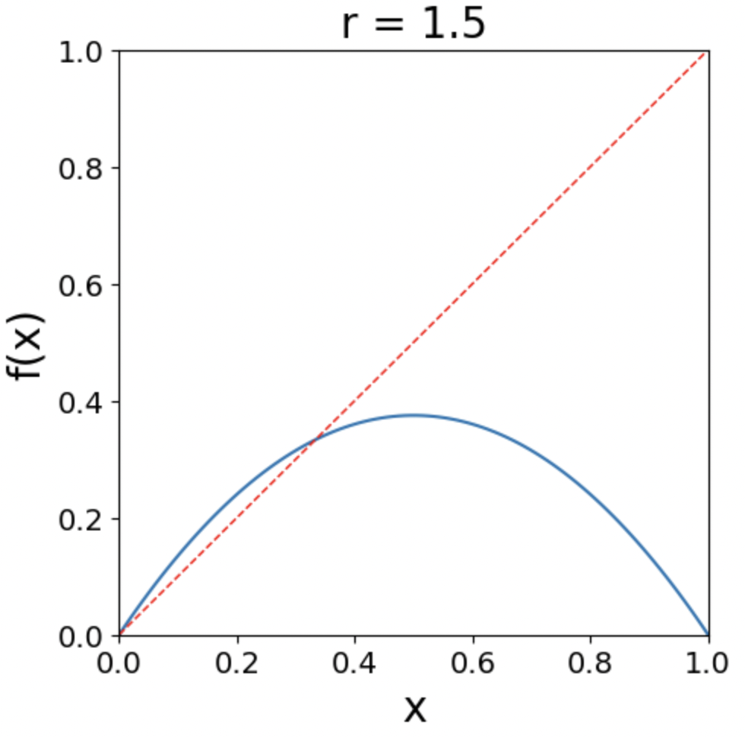

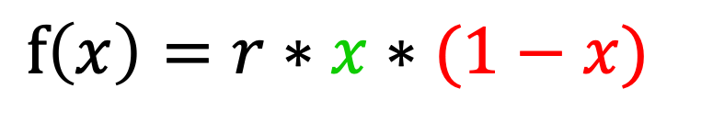
Excursion: Logistic Map
Simple, discrete model for population growth
growth rate, 0…4
$$f\left(x\right)=r∗x∗(1−x)$$
reproduction
starvation
current population size, as fraction of maximum possible size, 0…1

Slide 4
Excursion: Logistic Map
Simple, discrete model for population growth
growth rate, 0…4
$$f\left(x\right)=r∗x∗(1−x)$$
reproduction
starvation
current population size, as fraction of maximum possible size, 0…1
reproduction
dominates
starvation
dominates

Slide 5
Excursion: Logistic Map
Simple, discrete model for population growth
growth rate, 0…4
$$f\left(x\right)=r∗x∗(1−x)$$
reproduction
starvation
current population size, as fraction of maximum possible size, 0…1
fixed point

Slide 6
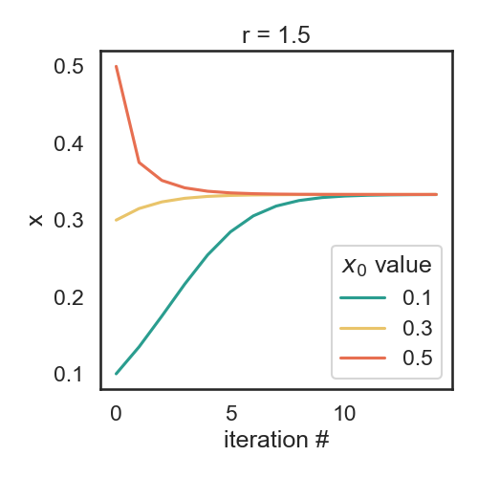
Excursion: Logistic Map
x₀ : initial population size
Iterated function: f(x₀)=x₁ -> f(x₁)=x₂ -> f(x₂)=x₃
converges
to fixed point

Slide 7
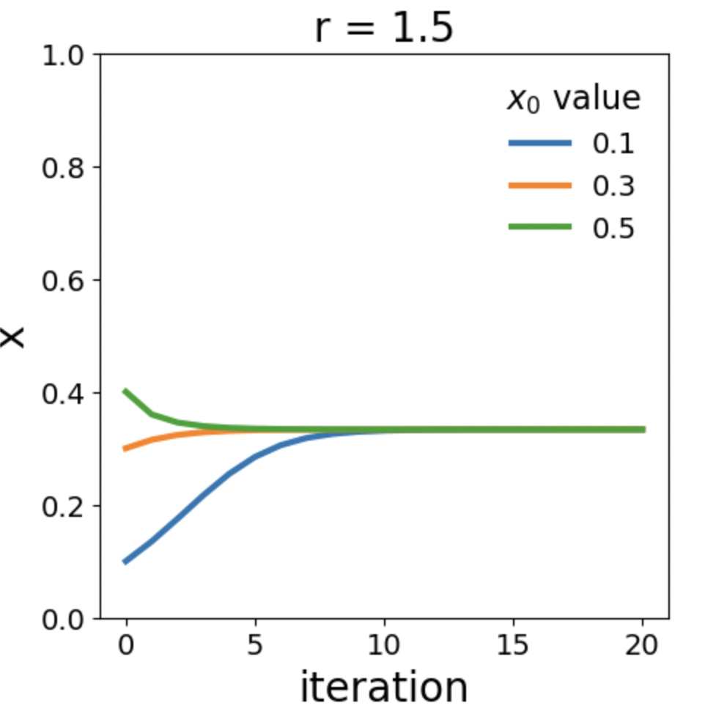
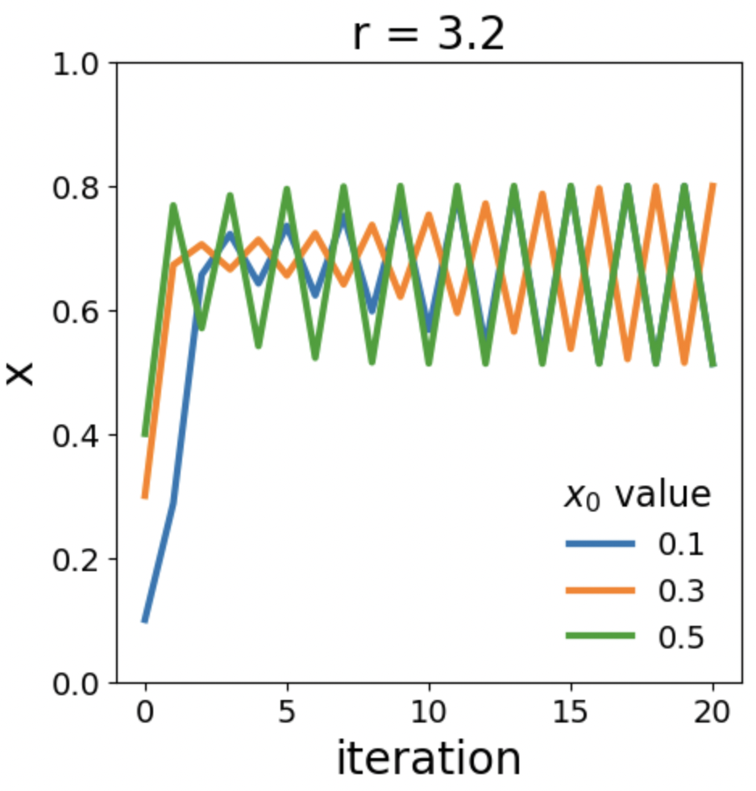
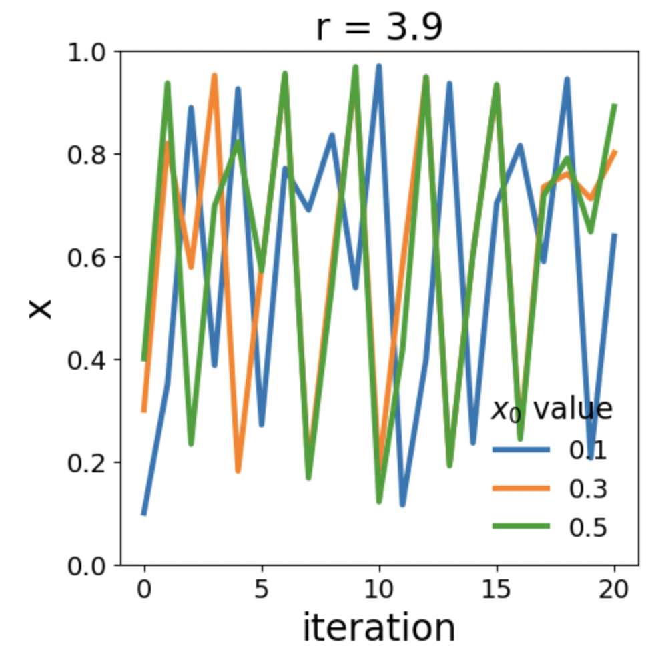
Excursion: Logistic Map
Different growth rates lead to a variety of population dynamics
Convergence to fix point
Convergence to oscillations
Chaos

Slide 8

Testing patterns

Slide 9
What a good test looks like
What does a good test look like? What should I test?
Good:
Short and quick to execute
Easy to read
Tests one thing
Bad:
Relies on data files
Messes with “real-life” files, servers, databases
Notes:
We saw how to test, but what is a good test? and what should we test?

Slide 10
Basic structure of test
A good test is divided in three parts:
Given: Put your system in the right state for testing
Create data, initialize parameters, define constants…
When: Execute the feature that you are testing
Typically, one or two lines of code
Then: Compare outcomes with the expected ones
Define the expected result of the test
Set of assertions that check that the new state of your system matches your expectations

Slide 11
Test simple but general cases
Start with simple, general case
Take a realistic scenario for your code, try to reduce it to the simplest example
Example: Tests for ‘lower’ method of strings
def test_lower(): # Given string = 'HeLlO wOrld' expected = 'hello world' # When output = string.lower() # Then assert output == expected

Slide 12
Test special cases and boundary conditions
Code often breaks in corner cases: empty lists, None, NaN, 0.0, lists with repeated elements, non-existing file, …
This often involves making design decision: handle corner case with special behavior, or raise a meaningful exception?
def test_lower_empty_string(): # Given string = '' expected = '' # When output = string.lower() # Then assert output == expected
Other good corner cases for string.lower():
‘do-nothing case’: string = 'hi'
symbols: string = '123 (!'
Notes:
First of all, you should start with testing your code with
explain typical test structure
show general case: two words, upper case chars randomly dispersed
special cases

Slide 13
Common for-loop pattern for testing multiple cases
Often these cases are collected in a single test:
def test_lower(): # Given # Each test case is a tuple of (input, expected_result) test_cases = [('HeLlO wOrld', 'hello world'), ('hi', 'hi'), ('123 ([?', '123 ([?'), ('', '')] for string, expected in test_cases: # When output = string.lower() # Then assert output == expected

Slide 14

Hands-on!
$$f\left(x\right)=r∗x∗(1−x)$$
Take a look at the logistic map
or, in Python
What should we test?
Generic cases
Corner cases
def f(x, r):
""" Compute the logistic map for a given value of x and r. """
return r * x * (1 - x)
Notes:
Generic: what would convince you that it works? would 1 value be sufficient? where do we find the values?
compute by hand, look it up, fixed points -- the important is that the source is independent
would writing the function, running it, then using the output as a test value be meaningful? only to avoid regressions
Corner cases: x = 0, x= 1
Error cases (r<=0, r>=4, x<0, x>1)

Slide 15
Hands-on! for
In the testing_project repository, open the file logistic.py and implement the logistic function, f(x, r)
In test_logistic.py we already added a reference test for these corner cases:
x=0, r=1.1 => f(x, r)=0
x=1, r=3.7 => f(x, r)=0
Add a new test for these generic cases using the for-loop pattern:
x=0.1, r=2.2 => f(x, r)=0.198
x=0.2, r=3.4 => f(x, r)=0.544
x=0.5, r=2 => f(x, r)=0.5

Slide 16
The for-loop pattern can be improved
It is repetitive to write the for-loop pattern
If one of the cases break, it can be complicated to figure out which one
pytest has many helpers for simplifying common testing cases!
One of them is the parametrize decorator, that simplifies running the same test with multiple cases

Slide 17
Simple example
def test_for_loop_simple(): cases = [1, 2, 3] for a in cases: assert a > 0
test_for_loop_simple runs once and loops over 3 test cases

Slide 18
Simple example, with the parametrize decorator
Name of the variable that varies
List of values for the variable
test_parametrize_simple runs 3 times with a=1, a=2, and a=3
@pytest.mark.parametrize('a', [1, 2, 3]) def test_parametrize_simple(a): assert a > 0
The test must take an argument with the same name
Notes:
Remember to import pytest!

Slide 19
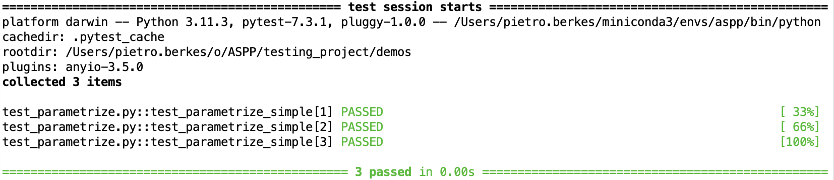
Simple example, with the parametrize decorator
Name of the variable that varies
List of values for the variable
@pytest.mark.parametrize('a', [1, 2, 3]) def test_parametrize_simple(a): assert a > 0
The test must take an argument with the same name
pytest automatically creates one separate test for each test case

Slide 20
Example with multiple values
This is a more typical case with several input values and the expected result of the test
def test_for_loop_multiple(): cases = [
(1, 'hi', 'hi’),
(2, 'no', 'nono’)
] for a, b, expected in cases: result = b * a assert result == expected
test_for_loop_multiple runs once and loops over 2 test cases

Slide 21
Same example, with the parametrize decorator
Name of all the variables, separated by commas in one string
List of tuples with the values for each varialbe, one for each test case
@pytest.mark.parametrize('a, b, expected', [(1, 'hi', 'hi'), (2, 'no', 'nono')]) def test_parametrize_multiple(a, b, expected): result = b * a assert result == expected
The test must take arguments with the same names as in the string
test_parametrize_multiple runs 2 times with 1) a=1 b=‘hi’ expected=‘hi’
and
2) a=2 b=‘no’, expected=‘nono’

Slide 22
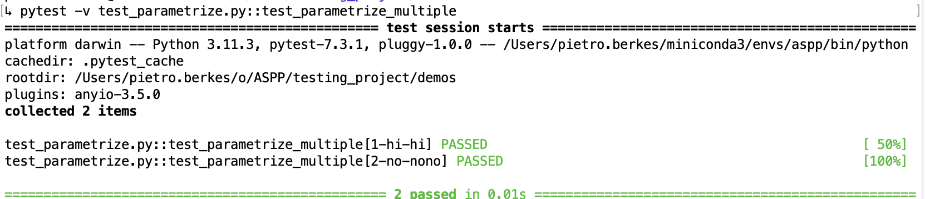
Same example, with the parametrize decorator
Name of all the variables, separated by commas in one string
List of tuples with the values for each varialbe, one for each test case
@pytest.mark.parametrize('a, b, expected', [(1, 'hi', 'hi'), (2, 'no', 'nono')]) def test_parametrize_multiple(a, b, expected): result = b * a assert result == expected
The test must take arguments with the same names as in the string
pytest automatically creates one separate test for each test case

Slide 23
Hands-on!
Rewrite the test with the generic cases for the logistic map using parametrize
Reference example for the corner cases test:
import pytest
@pytest.mark.parametrize('x, r, expected', [ (0, 1.1, 0), (1, 3.7, 0), ] ) def test_f_special_x_values(x, r, expected): result = f(x, r) assert_allclose(result, expected)

Slide 24
Hands-on! Simulate a population over time
Implement a function iterate_f that runs f for it iterations. Write tests for the following cases:
x=0.1, r=2.2, it=1 => iterate_f(it, x, r)=[0.1, 0.198]
x=0.2, r=3.4, it=4 => iterate_f(it, x, r)=[0.2, 0.544, 0.843418, 0.449019, 0.841163]
x=0.5, r=2, it=3 => iterate_f(it, x, r)=[0.5, 0.5, 0.5]
(Bonus) Import the plot_trajectory function from the plot_logistic module and use it to visualize the trajectories generated by your code. Try with values r<3, and 3<r<4 to get an intuition for how the function behaves differently with different parameters.

Slide 25
Strategies for testing scientific code

Slide 26
Strategies for testing learning algorithms
Learning algorithms can get stuck in local maxima, the solution for general cases might not be known (e.g., unsupervised learning)
Turn your validation cases into tests
Stability tests:
Start from final solution; verify that the algorithm stays there
Start from solution and add a small amount of noise to the parameters; verify that the algorithm converges back to the solution
Parameter Recovery: Generate synthetic data from the model with known parameters, then test that the code can learn the parameters back
Notes:
…
There is no general rule for testing these algorithm, for each specific algorithm there are usually validation cases (e.g, a classifier might be validated using two classes of very different objects)

Slide 27
Learning algorithms fit the parameters of a model to observed data
y = ax + b + noise
a = -1.2
b = 3

Slide 28
Generate synthetic data from the model to test the learning algorithm by recovering the parameters
1) Fix initial parameters
a* = 0.5
b* = -1.3

Slide 29
Generate synthetic data from the model to test the learning algorithm by recovering the parameters
1) Fix initial parameters
2) Generate synthetic data
y = a* x + b* + noise
a* = 0.5
b* = -1.3

Slide 30
Generate synthetic data from the model to test the learning algorithm by recovering the parameters
1) Fix initial parameters
2) Generate synthetic data
y = a* x + b* + noise
a* = 0.5
b* = -1.3
3) Run the algorithm
a = 0.5098
b = -1.287
y = ax + b + noise

Slide 31
Generate synthetic data from the model to test the learning algorithm by recovering the parameters
1) Fix initial parameters
2) Generate synthetic data
y = a* x + b* + noise
a* = 0.5
b* = -1.3
4) Compare
3) Run the algorithm
a = 0.5098
b = -1.287
y = ax + b + noise

Slide 32
Hands-on! Recover the population growth, r
In the module logistic_fit, we implemented a function fit_r that, given a population trajectory, finds the value of r that generated it
For example:
In [1]: from logistic import iterate_f
In [2]: from logistic_fit import fit_r
In [3]: xs = iterate_f(it=23, x0=0.3, r=3.421)
In [4]: fit_r(xs)
Out[4]: 3.4210000000000003

Slide 33
Hands-on!
Write a test for the function fit_r using the parameters recovery method
The test should
Set a initial value for x0 and r
Use iterate_f to generate a population trajectory
Pass the population trajectory to fit_r and collect the result parameters
Check that the fitted r is close enough to the original r
In [1]: from logistic import iterate_f
In [2]: from logistic_fit import fit_r
In [3]: xs = iterate_f(it=23, x0=0.3, r=3.421)
In [4]: fit_r(xs)
Out[4]: 3.4210000000000003

Slide 34

Randomness in Testing
Using randomness in testing can be useful
To check that the code is stable and works correctly in many different cases
To find corner cases or numerical problems
def test_logistic_fit_randomized():
random_state = np.random.RandomState(SEED)
for _ in range(100):
x0 = random_state.uniform(0.0001, 0.9999)
r = round(random_state.uniform(0.001, 3.999), 3)
xs = iterate_f(it=17, x0=x0, r=r)
recovered_r = fit_r(xs)
assert_allclose(r, recovered_r, atol=1e-3)
Notes:
numpy.random.RandomState!
random_state = np.random.RandomState(SEED)
random_state.rand()
otherwise using the global seed, if any external library uses np.random it can screw up the determinism

Slide 35
Random Seeds and Reproducibility
When running tests that involve radomness and some test doesn’t pass it is vital to be able to reproduce that test exactly!
Computers produce pseudo-random numbers: setting a seed resets the basis for the random number generator
This is essential for reproducibility
At a minimum, you should manually set the seed for each of your random tests
SEED = 42
random_state = np.random.RandomState(SEED)
random_state.rand()
Notes:
numpy.random.RandomState!
random_state = np.random.RandomState(SEED)
random_state.rand()
otherwise using the global seed, if any external library uses np.random it can screw up the determinism

Slide 36
Hands On!
Write a randomized test that checks that for r=1.5, for any random starting point x0, the logistic equation converges to 1/3
Write a for loop of 100 iterations, in each iteration create a random x0
For each value of x0, test that after many iterations in iterate_f the value of x is equal to 1/3

Slide 37
A Pytest Solution
Non-scientific coding uses random testing more rarely, so there is no helper tools for that in pytest
However, in scientific coding it is quite common
What do we want?
For each (random) test there should be a seed
For each run of the test, the seed should be different
That seed should be printed with the test result
It needs to be possible to explicitely run the test again with that seed!

Slide 38
Fixtures (minimal solution)
Fixtures are functions that are run before the tests are executed
import numpy as np
import pytest
# set the random seed for once here
SEED = np.random.randint(0, 2**31)
@pytest.fixture
def random_state():
print(f'Using seed {SEED}')
random_state = np.random.RandomState(SEED)
return random_state
def test_something(random_state): random_state.rand()
If an input argument of a test matches the name of a fixture, then the fixture is called and the return value assigned to the argument.
pytest handles that automatically as part of running the test suite
Notes:
If you want it to make a random seed for the whole module instead fo for every test, use “scope=‘module’”

Slide 39

Hands On!
Write a randomized test that checks that fit_r can recover r for any random value of x0 and r
Add a fixture at the top of your test file, that lets you print the seed to the console.

Slide 40
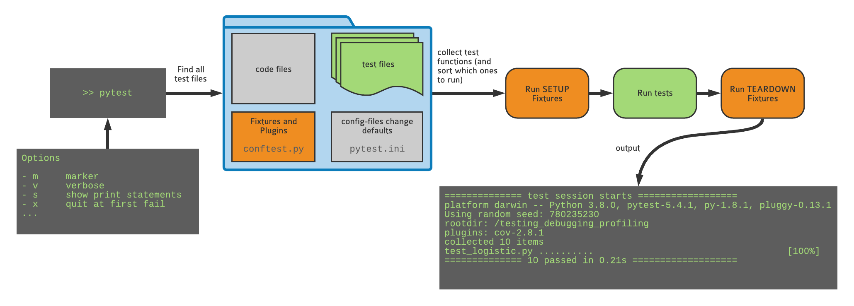
What happens when you run pytest

Slide 41

Fixtures (real solution)
conftest.py is a special pytest config file (don’t import it!)
conftest.py can be used to define custom behavior or plugins. Fixtures can also be defined here, so that they can be used by all tests.
See the file demos/conftest_example.py in the repo you forked. If you move it to the main folder and rename it, the functions defined there select a seed for each test and allow you to pass a seed on the command line using --seed 123

Slide 42
Hands On!
Write a randomized test that checks that fit_r can recover r for any random value of x0 and r
Add a fixture at the top of your test file, that lets you print the seed to the console.
Add the conftest.py file the root directory of the project (hint: it is hiding in the demos folder!). It sets a random seed before each run and makes it possible to reproduce failures in random tests
conftest.py defines a new random_state fixture, modify your test accordingly
Check that the console output of pytest now includes the seed!

Slide 43
Other commonly used helpers in pytest

Slide 44
Decorating “special” tests
@xfail: Expected failure, outputs an “x” (or “X”) in the report
@skip: Skip test, useful e.g. when the feature doesn’t exist yet
@skipif: Skip the test if a condition is met, useful for tests that only works on a specific platform, or for a specific version of Python
@pytest.mark.xfail
def test_something():
...
@pytest.mark.skip(reason=“functionality not yet implemented”)
def test_something():
...
@pytest.mark.skipif(sys.version_info < (3, 10), reason="requires python3.10 or higher")
def test_something():
...

Slide 45
Marking tests with custom markers
If you have lots of tests, you can categorize them with your own markers
although for custom mark names you need to register the marks “pytest.ini”
https://docs.pytest.org/en/7.1.x/example/markers.html#registering-markers
Example:
Smoke tests check for really basic features: run these frequently
Other tests may be many or too slow to run every time and test for more edge cases
@pytest.mark.smoke
def test_something_basic():
...
> pytest –m smoke
> pytest –m ”smoke and not slow”

Slide 46
Writing temporary files: tmp_path
To test functions that write to disk without leaving around the files when the test is finished, use the tmp_path fixture
The value of tmp_path is a pathlib.Path object
The directory is created at the start of the test, and removed at the end
def test_create_file(tmp_path):
d = tmp_path / "sub"
d.mkdir()
p = d / "hello.txt"
content = "some random text"
p.write_text(content)
assert p.read_text() == content
assert len(list(tmp_path.iterdir())) == 1
All you need to do is add an argument with this exact name

Slide 47
Final exercise

Slide 48
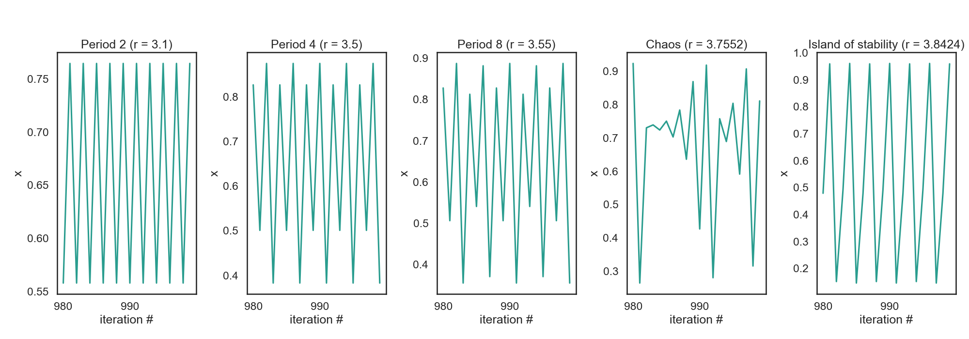
Excursion: Logistic map
Between r=3 and r=4 the logistic map has a range of behaviors
Periodic vs. chaotic

Slide 49
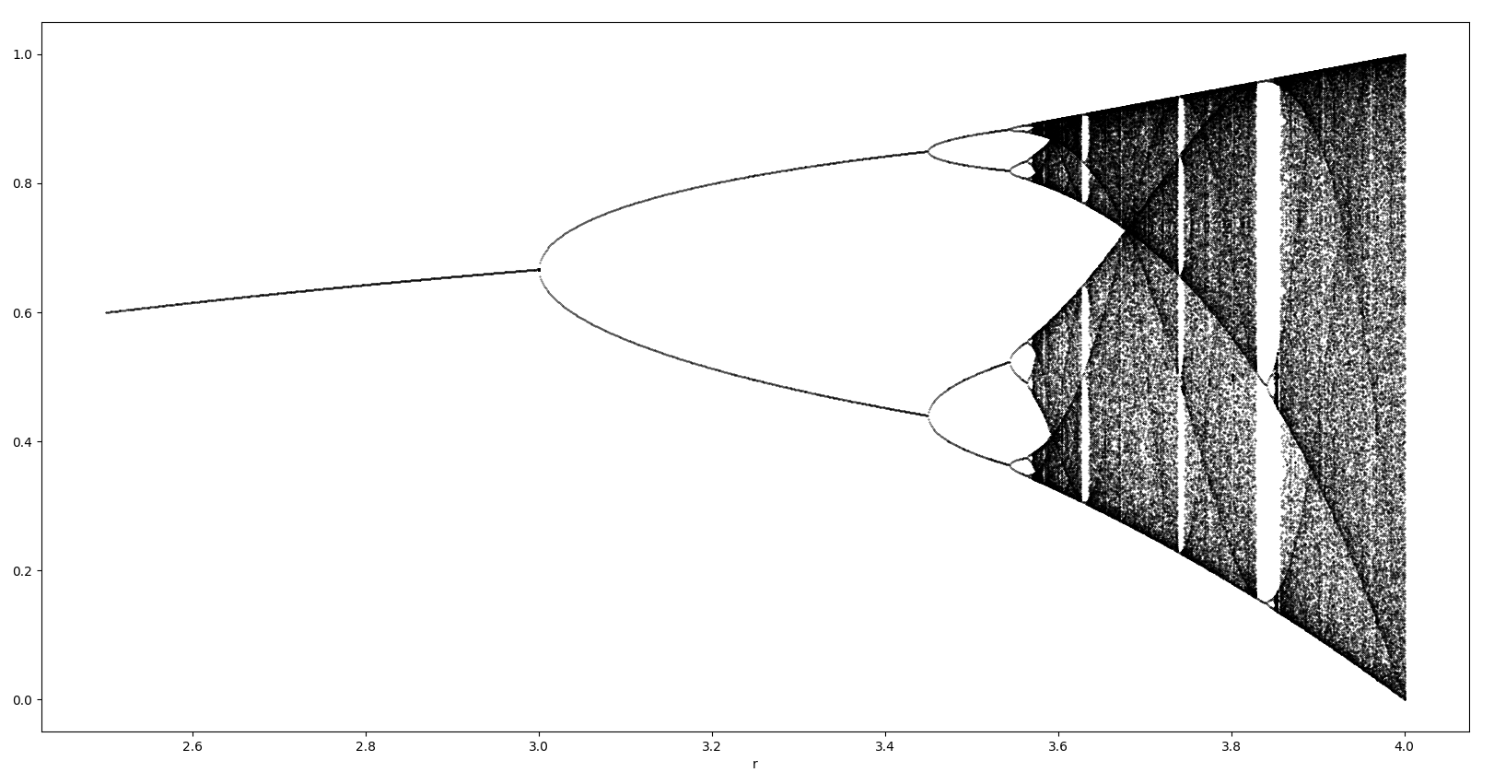
Excursion: Logistic map

Slide 50
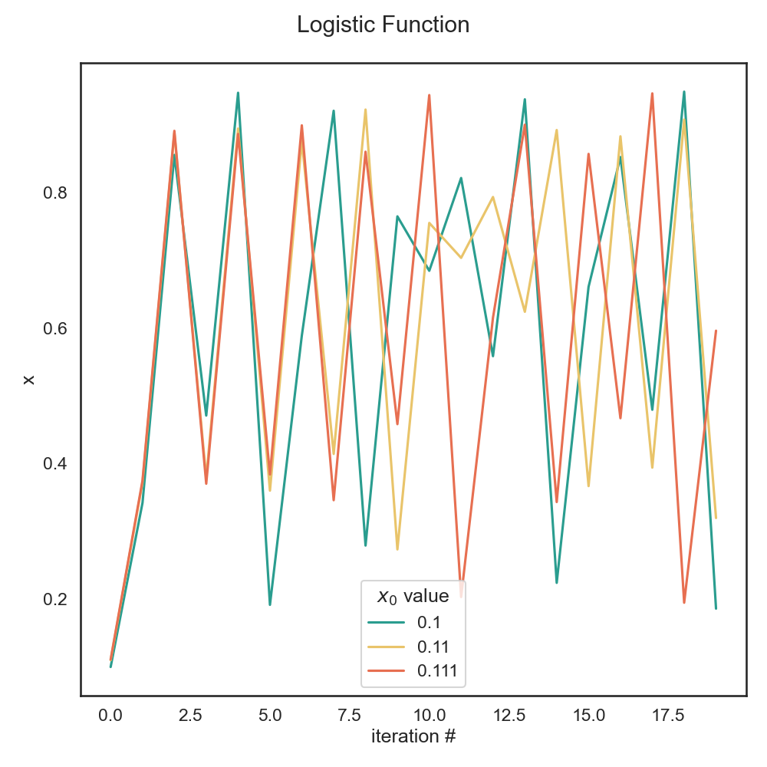

Excursion: Logistic map and chaos
Sensitive Dependence on Initial Conditions (SDIC)
Even starting points that are very close quickly diverge to completely different itineraries
This is called the “Butterfly effect”

Slide 51
Hands on!
Some r values for 3 < r < 4 have some interesting properties: a chaotic trajectory neither diverges nor converges.
a) Use the plot_bifurcation function from the plot_logfun module using your implementation of f and iterate to look at the bifurcation diagram. The function generates an output image, bifurcation_diagram.png
b) Write a test that checks for chaotic behavior when r=3.8. Run the logistic map for 100’000 iterations and verify the conditions for chaotic behavior:
1) The function is deterministic: this does not need to be tested in this case
2) Orbits must be bounded: check that all values are between 0 and 1
3) Orbits must be aperiodic: check that the last 1000 values are all different
4) Sensitive dependence on initial conditions: this is the bonus exercise (in readme)
The test should check conditions 2) and 3)!

Slide 52

Testing is good for your self-esteem
Immediately: Always be confident that your results are correct, whether your approach works of not
In the future: save your future self some trouble!
If you are left thinking “it’s cool but I cannot test my code because XYZ”, talk to us during the week and we’ll show you how to do it ;-)
You, in 2023
You, in 2024

Slide 53



Debugging
Up next:

